Slide 1

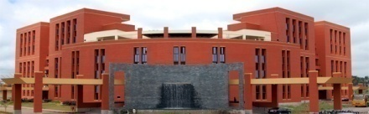
Project Phase-I
Analysis of malicious URLs using Machine Learning
Project team members:
Ankita Aditya 1PE17CS023
Atul K Uchil 1PE17CS029
Mitali Singh 1PE17CS182
Prescilla Angel 1PE18CS419
Guide: Prof Sudeepa Roy Dey
1
Notes:
1

Slide 2
Analysis of malicious URLs using Machine Learning
Problem definition
Malicious Web Sites is a cornerstone of Internet criminal Activities. It is one of the most important issue on web. We often click on some random URLs which redirect us to a malicious websites without our concern. Many such URLs are increasing at a rapid speed day-by-day. The model that we are proposing uses lexical analysis, which parses the URL and identify whether it’s malicious or benign. We are adding a chrome extension to alert the users in real time, thereby protecting the users from these malicious URLs.
Guide: Prof Sudeepa Roy Dey
2
Notes:
2

Slide 3
Analysis of malicious URLs using Machine Learning
Requirements
Functional Requirements
Product Feature:- Real-time detection for safe URLs.
User Requirements:- Download chrome extension.
Non- Functional Requirements
Usability: Degree to which a product or system can be used by specified users to achieve specified goals with effectiveness, efficiency, and satisfaction in a specified context of use.
Security: Degree to which a system protects information and data, so that persons or other products or systems have the degree of data access appropriate to their types and levels of authorization.
Performance: Performance relative to the amount of resources used under stated conditions.
Availability: Describes how likely the system is accessible for a user at a given point in time.
Guide: Prof Sudeepa Roy Dey
3
Notes:
3

Slide 4
Analysis of malicious URLs using Machine Learning
Data Flow Diagrams
DATASET
Model Trained using dataset
MODEL
Input URL
Output classification
USER
Guide: Prof Sudeepa Roy Dey
4
Notes:
4

Slide 5

Analysis of malicious URLs using Machine Learning
Use case Diagram
Stores the input URL
Detect malicious URLs
Alert User
Proposed System
Store Blacklist
Store Previous History
Guide: Prof Sudeepa Roy Dey
5
Notes:
5

Slide 6
Analysis of malicious URLs using Machine Learning
Sequence Diagram
Client
Browser
Web Page
Sends request for an URL
Displays the requested web page
Role of extension
Activates extension
Reads the current visited URL
Stores the URL
Runs the algorithms to detect URL as malicious or benign
Sends result to the user
Stores the URL in blacklist or whitelist
Guide: Prof Sudeepa Roy Dey
6
Notes:
6

Slide 7
Analysis of malicious URLs using Machine Learning
State Transition Diagram
Online Update
Data set
Malicious URL
Input Source
Start
Live URL Feed
Feature Collector
URL
Features extracted
Classifier
Results
End
Collection of labelled URL Data
Benign URL
Online Update
Guide: Prof Sudeepa Roy Dey
7
Notes:
7

Slide 8
Analysis of malicious URLs using Machine Learning
Detailed design
User Interface
Activate the extension while surfing web
Display the result (malicious or benign)
Extension
API, a medium of communication between the user and the model
Model
Feature Extraction
Predictor
Classification
Guide: Prof Sudeepa Roy Dey
8
Notes:
8

Slide 9
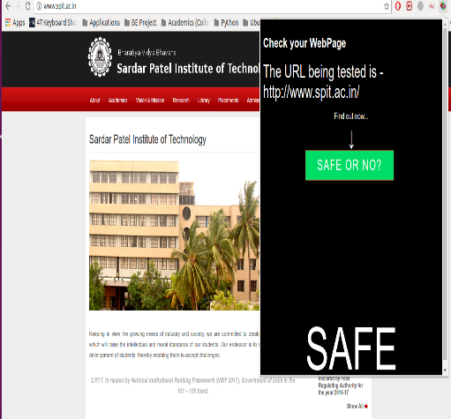
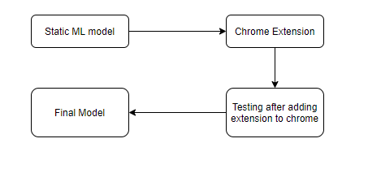
Analysis of malicious URLs using Machine Learning
Detailed design
Four Phases of the model
Working model example
Guide: Prof Sudeepa Roy Dey
9
Notes:
9

Slide 10
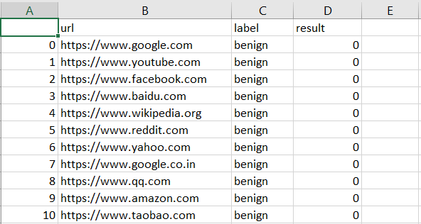
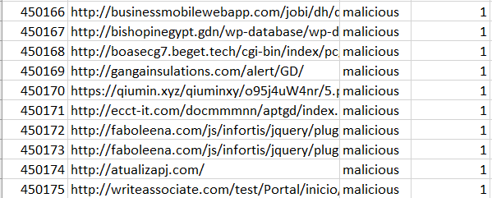
Analysis of malicious URLs using Machine Learning
The development environment
Hardware Requirements
Any suitable computer
with internet connection.
Processor – Intel i3 or higher
Hard disk – 256 GB or higher
Dedicated RAM – minimum 4GB
Software Requirements
OS – Windows, Linux, iOS
Browser – Chrome
Programming Language – Python
Python IDE – Jupyter, PyCharm
Dataset:
Data columns: 3
url: 450176
label: 450176
result: 450176
data types: int64(1), object(2)
Benign URLs: 345738
Malicious URLs: 104438
Head of dataset
Tail of dataset
Guide: Prof Sudeepa Roy Dey
10
Notes:
10

Slide 11
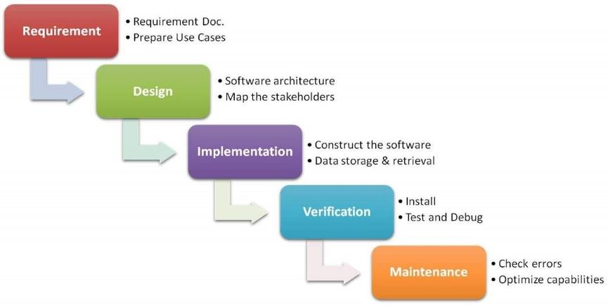
Analysis of malicious URLs using Machine Learning
Implementation approach
We are following waterfall model approach which involves breakdown of project activities into linear phases.
Model the needs and functionalities of software product
-Design architecture -Use case diagram
-Sequence diagram -State transition diagram
-Code the application
-Pre-processing data
-Data Storage and retrieval
-Testing
-Debugging
-Optimization
-Checking errors
Guide: Prof Sudeepa Roy Dey
11
Notes:
11

Slide 12
Analysis of malicious URLs using Machine Learning
Documentation status
Project is currently on process and done with the
Chapter 2 : Software Requirement Specification
Software Requirement Specification
Operating Environment
Functional Requirements
Non-functional Requirements
Chapter 3 : High Level Design
High level design
Design considerations
Data Flow Diagram
Activity Diagram
Use Case Diagram
Sequence Diagram
State Transition Diagram
Guide: Prof Sudeepa Roy Dey
12
Notes:
12

